Slide 1

PLAY & SING
HIS PRAISES
HOME SCHOOL
MUSIC PROGRAM
2025-2026 Handbook Slides

Slide 2
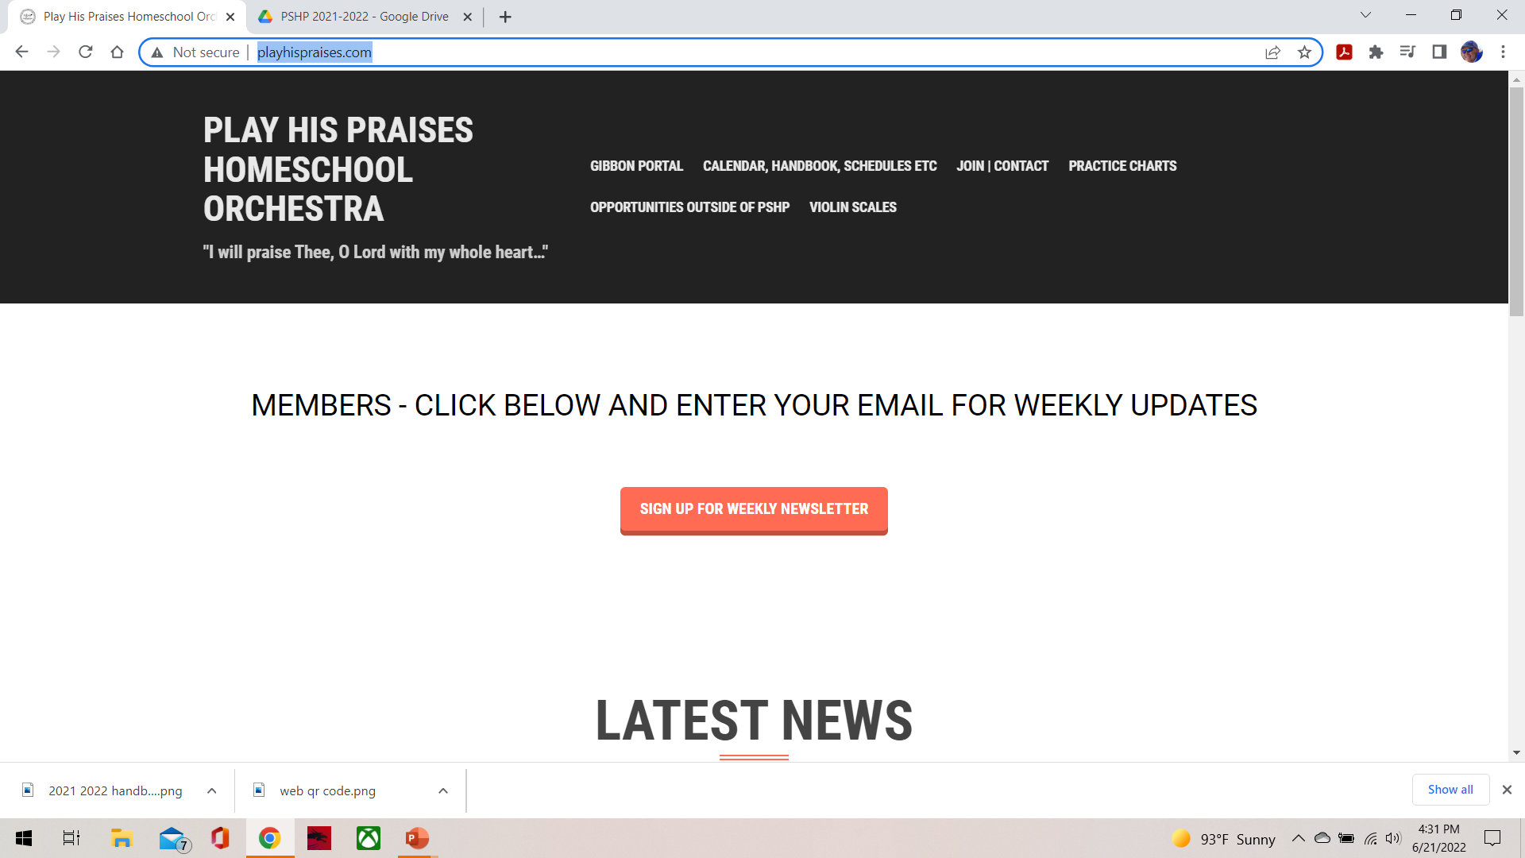
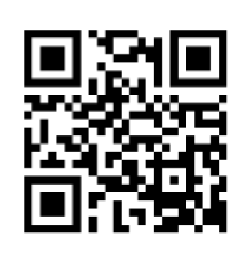
http://playhispraises.com
Important! Sign up for Weekly Newsletter on website:
WEBSITE QR

Slide 3
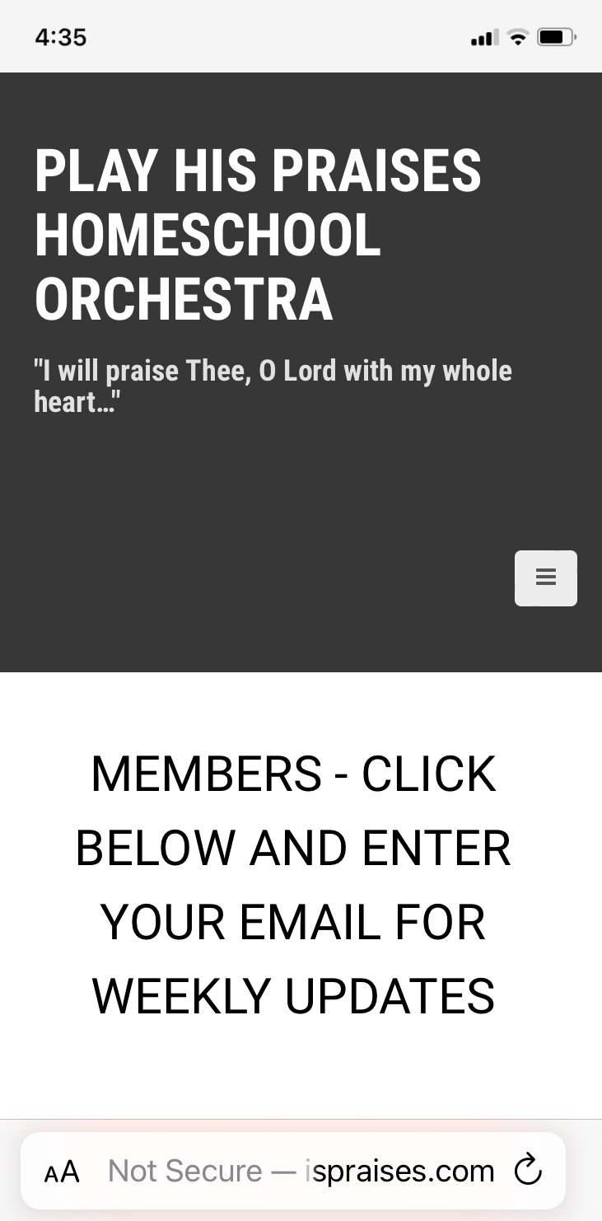
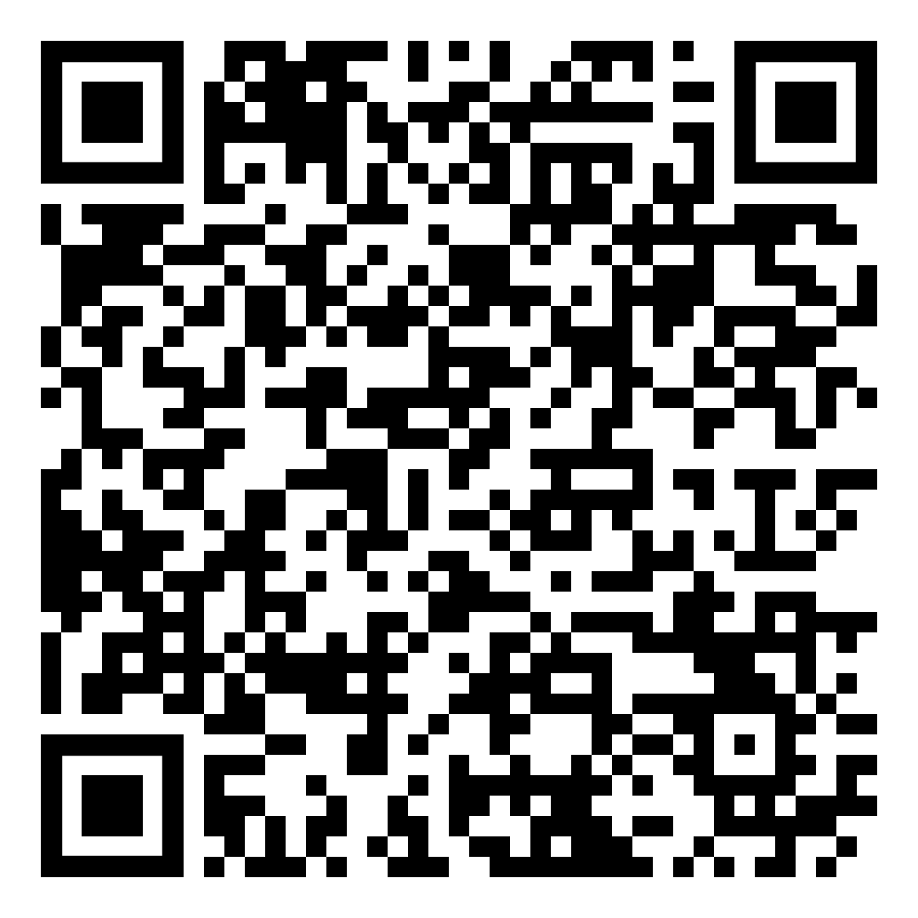
For 2025-2026 Handbook
WEBSITE
MOBILE
2025-2026 HANDBOOK QR

Slide 4
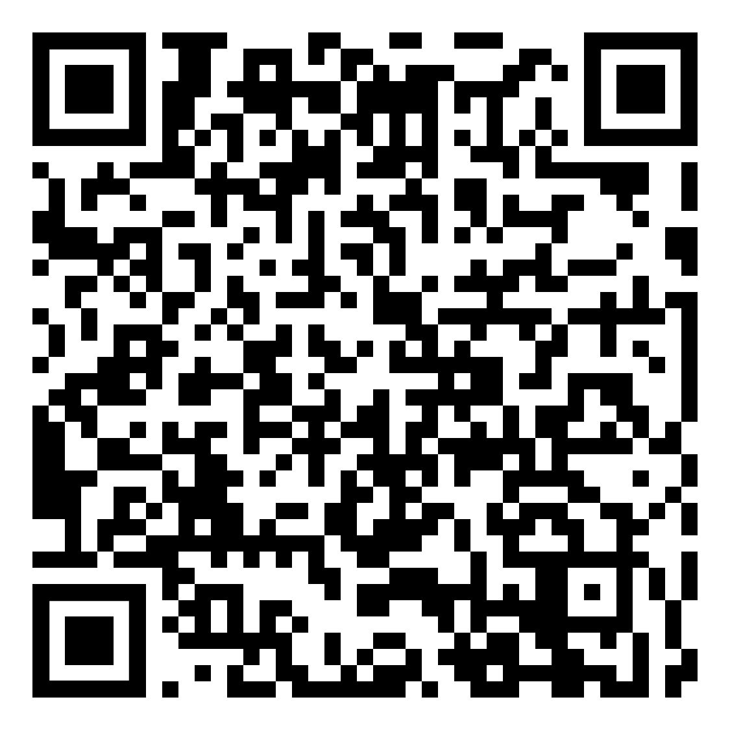
This Slide Show
Google Slides Link
PDF Slides Link

Slide 5
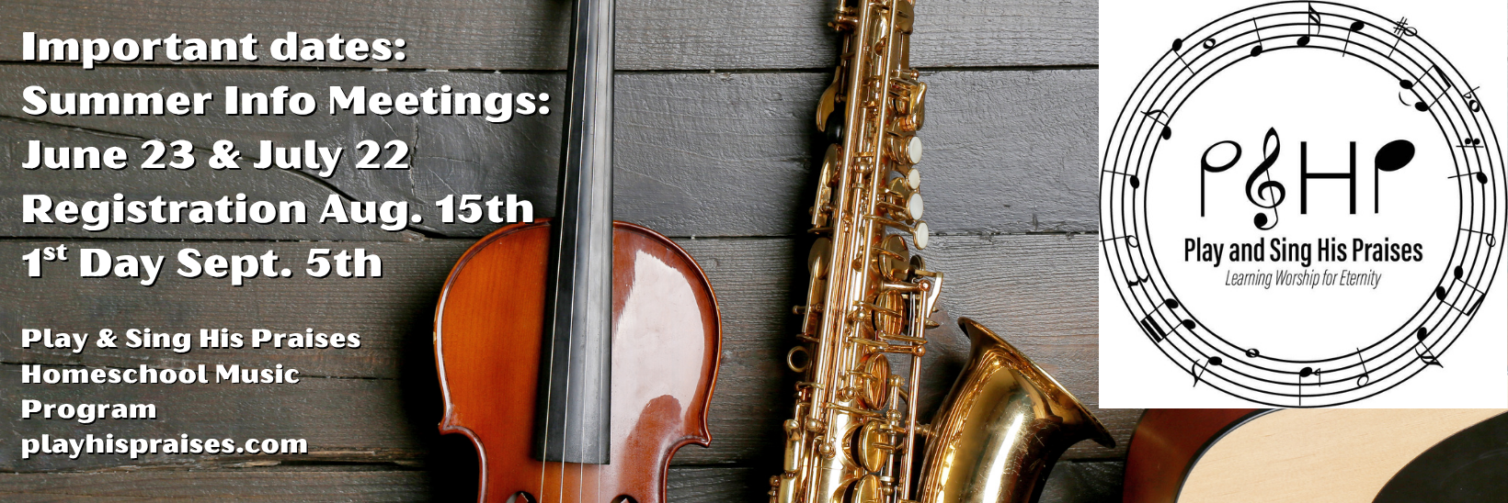
Facebook: (public page)
“Play and Sing His Praises”

Slide 6
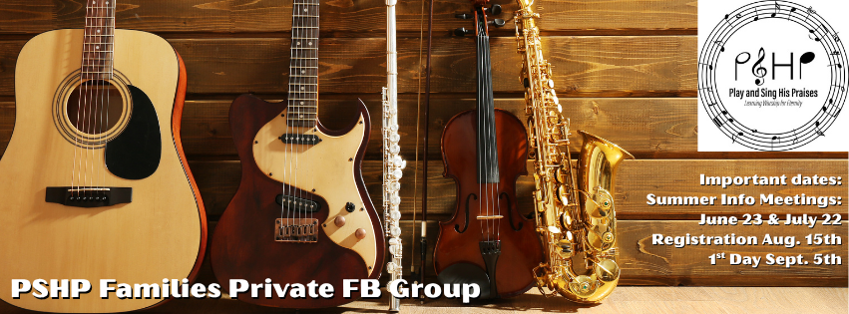
Facebook: (private group)
“PSHP Families”

Slide 7
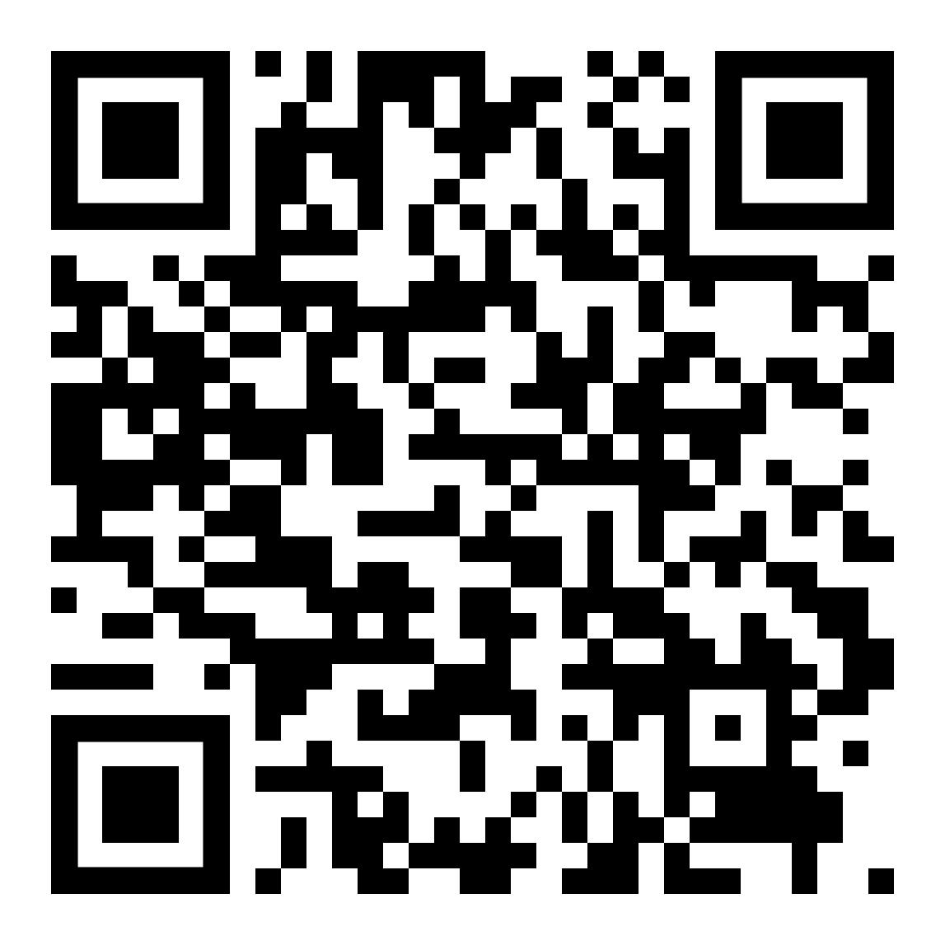
Enroll on JackRabbit
If attending, or completed required info meeting
This is only for those who have registered for PSHP already in person & have specifically been instructed to register w/ JackRabbit
Click Here for
Web link

Slide 8
Mission Statement (1/2)
Play and Sing His Praises Home School Music, here after referred to as PSHP, is a Christ-centered organization with the purpose of providing quality music instruction for the students of Christian homeschooling families. Our goal is to encourage Christian students in their love of music using music from many genres, time periods, and backgrounds:

Slide 9
Mission Statement (2/2)
Classical, Christian, movie themes, appropriate popular music, etc. It is our hope and prayer that students will gain an understanding and appreciation for music that will last a lifetime and be shared with others to the glory of God.

Slide 10
History
1998 Bethesda Christian Fellowship with
18 students
2000 Orchestra for any homeschooling
student and theory classes
2006 Home School Guitar instruction
2007 Home School Choir
2009 Home School Band

Slide 11
http://playhispraises.com
CHECK FOR THE LATEST NEWS, ANNOUNCEMENTS, UPDATES, & SCHEDULE CHANGES
CHECK ON CLASS ASSIGNMENTS (new JackRabbit)
REGISTER (SIGN-UP) FOR THE WEEKLY NEWSLETTER
DOWNLOAD ANY FORMS , like Practice Charts, Handbook & Schedule

Slide 12
Membership Guidelines
8 years old by September 1
Christian family, Home Schooled 100%
with a parent/guardian as teacher
Exceptions ONLY for upper level high school classes or dual enrollment classes w/ college

Slide 13
The Director’s Board
Formed in 2012 to assist Kathy Love in carrying out the vision and mission of PSHP. A member is available each Friday to assist in any non-music related issues. Concerns or suggestions should be shared with the board member, placed in the suggestion box at the information table, or submitted on the website for Board review.

Slide 14
The Benefits to Your Child
Self-Expression, Creativity, and Achievement
Problem solving
Teamwork
Goal setting
Coordination & Memory skills
Self-Confidence & Esteem
Poise and much more!!!

Slide 15
The Benefits to Your Family
Shared family experiences
Family music-making
Performing for family & friends
Learning about composers their world
& cultural heritage
Music for Worship

Slide 16
Supporting Your Child’s Musical Education
Parental support, attitude, and involvement are essential factors in a child's ability to successfully learn to play and to enjoy music
With the right support from you, playing music will become a natural part of your child's life

Slide 17
Ways to Support Your Child (1/2)
Read the weekly update for announcements and assignments or check the website.
Encourage your child’s attendance in all
playing, singing and theory classes.
Encourage your child to practice the weekly
assignment.
Encourage your child to play for family and
friends.

Slide 18
Ways to Support Your Child (2/2)
Offer compliments & encouragement regularly
Expose your child to a wide variety of music
Talk about music learned in the class
Provide an instrument in good working order
Listen to your child practice and acknowledge improvement.
Make a minimum two-year commitment to music studies.

Slide 19
Practice at Home is Key!
Make practice a part of your daily homeschool schedule (Not Just Fridays)
15 minutes x 5 days at beginning
At least 30 minutes x 5 days regular practice is our goal
Keep a Practice Chart
Watch for Assignments Online
Rewards given in classes and at end of semester

Slide 20
Things to Avoid
Don't use practice as a punishment.
Don't insist your child play for others.
Don't make fun of mistakes or less-than-perfect playing.
Don't start on an instrument in poor condition.
Don't expect rapid progress and development in the beginning.

Slide 21
Class Information and Prerequisites
Age requirements met by September 1
All students attend at least 2 hours of classes;
1 Performing & 1 Theory
Be in class ready to sing, play or learn at the beginning of each class (arrive early to set up)

Slide 22
ORCHESTRAS (1/3)
Beginner Orchestra
8 years old & up -No previous experience
Intermediate Orchestra
9 years old & up - Audition
Finish PSHP Theory Book
Advance Int Orchestra
10 years old & up - Audition
Finish AFS Theory Book 1

Slide 23
ORCHESTRAS (2/3)
Bach Orchestra
12 years old & up - Audition
Finish Theory Book 1 & 2
Beethoven Orchestra
14 years old & up –
Strings & Band Audition
Brahms Chamber Ensemble
15 years old & Audition

Slide 24
ORCHESTRAS (3/3)
Orchestra Instruments:
Recommended for Beginners:
Violin
Viola
Cello
Harp (at least 28 strings)
String Bass with teacher approval

Slide 25
Bands (1/2)
Recorder Class (1yr)
8 & 9 yrs old, No previous experience
Beginner Bells Percussion (Percussion Intro)
8 & 9 yrs old, No previous experience
Beginner Band
10 yrs old & up OR
9 yrs old and Recorder Class or Bell Class
Intermediate Band
10 years old & Audition
Finish Note Speller Theory Book

Slide 26
Bands (2/2)
Adoration Band
12 years old & Audition
Finish Practical Theory 1 & 2
Select Ensembles (Clarinet, Flute, Etc)
14 years old & Audition, Theory 1 & 2.
Be member of Adoration
Jazz Ensemble
(same)
Percussion Ensemble
(same)

Slide 27
Bands - Instruments
Recommended for Beginners:
FLUTE
CLARINET
SAXOPHONE
TRUMPET
TROMBONE/BARITONE (TUBA)
BELLS / PERCUSSION
2nd or 3rd year –
OBOE, FRENCH HORN, TUBA

Slide 28
Guitars
Beginner Guitar
10 years old OR
9 years old & Recorder
Intermediate Guitar
10 years old & Audition
Advance Guitar
12 years old & Audition, Theory
Classical Guitar Ensemble
14 years old & Audition & Adv. Guitar

Slide 29
Choirs (1/2)
Singers Choir
8 – 10 years old
No Audition, No experience
Mezzo Choir
11 -13 years old*
No Audition, No experience
*Mezzo Choir students that are 13 and have 2 years in Mezzo are eligible for Concert Choir

Slide 30
Choirs (2/2)
Concert Choir
14 years old & up
No Audition, No experience
Theory (New at 10:00; others at 1:45)
Bel Canto Chamber Ensemble
15 years old & up
Audition & Concert Choir
Theory

Slide 31
Miscellaneous
Praise & Worship Ensemble
14 yrs & Audition
& in another large ensemble
Harp Ensemble (Beginner & Int.)
Open to any harp student
& in an orchestra

Slide 32
Friday Schedule
8:45 AM
Instrumental | Theory | Choirs/Guitar/ Other
Beginner Band |  | Bel Canto
Beginner Bells Perc.
Beginner Guitar
Beginner Orchestra

Slide 33
Friday Schedule
10:00 AM
Instrumental | Theory | Choirs/Guitar/ Other
Intermediate Band | Beg. Band Theory | Praise & Worship
Intermediate Guitar | Beg. Bells Theory
Intermediate Orchestra | Beg. Guitar Theory
Adv. Intermediate | Beg. Orchestra Theory
Orchestra | Intro to Choir Theory
 | Recorder Theory

Slide 34
Friday Schedule
11:00 AM
Instrumental | Theory | Choirs/Guitar/ Other
Percussion Ensemble | Intermediate Band | Concert Choir
Recorder Class | Intermediate Guitar
Select Wind Ensemble | Intermediate Orchestra
 | Adv. Intermediate Orchestra Intermediate Harp

Slide 35
Friday Schedule
12:00-12:30
Combined Rehearsals (High School Students)
Teacher's Meetings Independent Theory Classes
12:45 PM
Instrumental | Theory | Choirs/Guitar/ Other
Adoration Band* | Singer Choir Theory | Harp Ensemble
(students wanting Adoration | Independent Theory Upper Level Theory | Classical Guitar Ensemble
Band & Mezzo Choir can take Concert Choir) |  | *Mezzo Choir

Slide 36
Friday Schedule
1:45 PM
Instrumental | Theory | Choirs/Guitar/ Other
*Bach Orchestra | *Mezzo Choir Theory | Singers Choir
(students in both Bach and Mezzo Theory can take Independent Theory) | HS Theory 1 HS Theory 2
 | College Prep Theory
 | Music Composition
 | Music History Adoration Band Th. 1st yr

Slide 37
Friday Schedule
2:45 PM
Instrumental | Theory | Choirs/Guitar/ Other
Beethoven Orchestra | Bach Theory | Select Wind Ensemble-Flutes
Jazz Ensemble | Independent Theory
3:45 PM
Instrumental
Brahms Chamber Ensemble Advance Guitar

Slide 38
Independent Theory
Independent theory is available at multiple times for students who have a schedule conflict with one of their theory classes. Students will work with a theory teacher who oversees them working on their own during this hour.
10:00am, 12:00pm, 12:45pm, 2:45pm

Slide 39
Instrument Care
THE FOLLOWING ARE THE RESPONSIBILITY OF THE PLAYER:
1. Avoid extremes in temperature. If the environment is OK to leave a baby, it would be OK for a string instrument. 50 to 80 degrees and not in direct sunlight are best for transporting and storage.
2. Check the humidity and buy a dampit for string instruments if needed, especially in the dry winter.
3. Do not drop or bump your instrument. Watch how you walk through doorways!

Slide 40
Instrument Care
THE FOLLOWING ARE THE RESPONSIBILITY OF THE PLAYER:
4. Clean your instrument after you play. Wind players need to swab spit and string players need to wipe off rosin. Occasionally clean instruments with an appropriate cleaner that can be purchased.
5. Check that the tilt of the bridge on string instruments is correct and leans backward just a little. Check that the feet of the bridge are flat against the top of the instrument.
6. Check strings for wear, fraying, or unraveling. They should be replaced at least every year or two for the best sound.

Slide 41
Instrument Care
THE FOLLOWING ARE THE RESPONSIBILITY OF THE PLAYER:
7. Always loosen the bow after each practice. Bows will need to be re-haired with horsehair at least every 2 years, or more often depending on usage.
8. Do not let beginners tighten the strings with the pegs until they learn how, as it is very easy to break a string. Strings are cheapest if bought in sets. Students can adjust the fine tuners, "righty tighty" raises the pitch, and "lefty loosey" lowers the pitch.
9. Find a safe place to store your instrument when not being played.

Slide 42
REPAIRS BEST LEFT FOR THE REPAIR PERSON
OR A TEACHER:
1. Replacing the strings for the first time should be done by your teacher. Tightening a very loose string should not be done by beginners as the strings can be over tightened and break very easily!
2. Do not attempt to use glue on anything on your instrument. See a repair person to fix all cracks as soon as you notice them.
3. Do not attempt to play your string instrument if the sound post has fallen down on the inside of the instrument and is rolling around. See a repair person.

Slide 43
REPAIRS BEST LEFT FOR THE REPAIR PERSON
OR A TEACHER:
4. Any adjustments that need to be made involving adjusting the wooden parts should be seen by a repair person.
5. Any worn pads on Band instruments should be replaced.

Slide 44
Instrument Supplies 1/2
Ernie Williamson Music Palen Music
(Springfield Music) 1560 E. Raynell Place
3100 S. Fremont Ave. Springfield, MO 65804
Springfield, MO 65804 417-882-7000
417-881-1373 https://palenmusic.com
https://springfield-music.com

Slide 45
Instrument Supplies 2/2
The Acoustic Shop Guitar Center
1913 E. Seminole 3500 S. Glenstone
Springfield MO 65804 Springfield, MO 65804
417-720-1223 (417) 885-1106
Guitars/Stringed Instruments Guitars, Perc, some instr. www.theacousticshoppe.com supplies
www.guitarcenter.com

Slide 46
Basic Instrument Supplies
Folding Music Stand (suggest upgrade beyond wire stand)
Folders/Binders
Pencils
Bag
Label all items
See Teachers for instrument specific needs

Slide 47
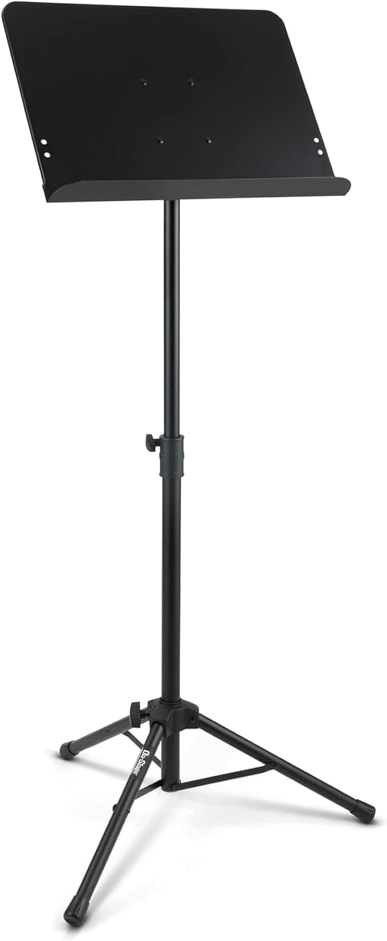
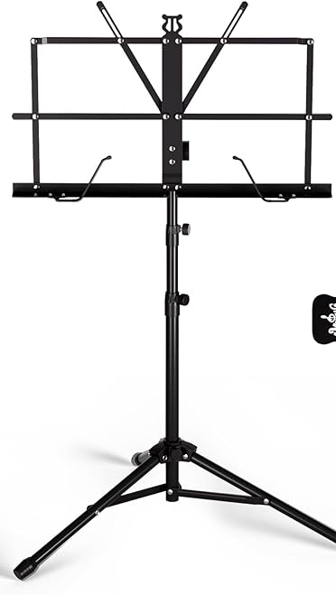
Basic Instrument Supplies
$15
Replace
Every year
On-Stage SM7211B
$56

Slide 48
Class Fees & Payments
Two Hours of Instruction Sliding Fee (Perform + Theory)
$ is per Friday
1st Classes 2nd Classes & +
Oldest in family $12 $10
2nd Child in $10 $10
and all other
children in family
Instrument rentals (if available) are $10 per month

Slide 49
Class Fees & Payments
Upper level students that are enrolled in 3 hours of instruction will be charged an additional $5 per small/select ensemble.
(Two Performing groups, 1 Theory Class)
The classes that are labeled as Ensemble classes can not be taken by themselves-Jazz Ensemble, Percussion Ensemble, Flute Ensemble, Select Wind Ensemble, Clarinet Ensemble, Harp Ensemble, Praise and Worship Ensemble, Bel Canto Chamber Ensemble, and Brahms Chamber Orchestra Ensemble.

Slide 50
Class Fees & Payments
Additional Fees beyond classes:
Building Use: $7 per month, per family
Concert Fee: $10 per concert, per family

Slide 51
Payment Info
Due First Fridays
(Except for September fees which are due September 19th)
Payments are for how many Fridays are scheduled each month, Sept. Thru April.

Slide 52
Payment Info
Fees in May will be adjusted to accommodate cancelled classes.
We are scheduled to meet 29 Fridays this year.
If there are no cancellations or snow days.
You are not charged for cancelled classes.

Slide 53
Payment Info
Your family balance
& payment is available at the payment table or on JackRabbit.
Payment table is open 8:45am - 3:00 pm
Cash, Checks or Credit card.
Make your checks payable to: Play and Sing His Praises, PSHP, or Kathy Love.

Slide 54
Cancellation Policy
Classes – If the Springfield Public Schools close due to weather, we will cancel for that day.
An update will be emailed and the website will be updated by 6:30 a.m.
You will not be charged for classes cancelled by PSHP.

Slide 55
Cancellation Policy
Cancellation Call List: Please sign up on the Cancellation Call List at Registration if you do not have access to online updates at home.
Performances – If a performance has to be cancelled you will be notified at least 2 1/2 hours before the event.

Slide 56
Sickness Policy
Please be considerate of others and help minimize the spread of germs.
Do not attend if anyone in your family has had the flu or a stomach virus within the last 24 hours.
Do not attend if you have had a fever of over 100 degrees within the last 24 hours.

Slide 57
Sickness Policy
To clarify fever free, means without medication to reduce the fever, for at least 24 hours before returning to class.
Your student may return to class after taking antibiotics for over 24 hours for a contagious, infectious ailment (strep throat, etc).
PSHP does not give monetary credit for any missed classes due to illness.

Slide 58
Nursery Policy
The church nursery is reserved only for children of PSHP teachers.

Slide 59
General Dress Code for PSHP Classes
Appropriate and Modest Clothes for
All Classes and functions.
1. All shirts must have some type of sleeve and remain on the shoulders. All sleeveless, spaghetti strap, or tank type style of shirts must have a jacket or other sleeved shirt over them at all times.
2. No short shorts. Bermuda style shorts or long basketball style shorts are ok. Your thighs should be covered at all times.

Slide 60
General Dress Code for PSHP Classes
Appropriate and Modest Clothes for
All Classes and functions.
3. Please check to make sure that no skin or undergarments are showing if you raise your arms above your head.
4. Tight fitting, low cut, or see through clothing is inappropriate.
5. Please remove your hats during times of prayer.

Slide 61
General Dress Code for PSHP Classes
Appropriate and Modest Clothes for
All Classes and functions.
6. GIRLS: Modesty at PSHP means that no cleavage is showing at anytime. Please make sure your shirts are appropriate even when bending over or sitting on the floor.

Slide 62
General Dress Code for PSHP Classes
Appropriate and Modest Clothes for
All Classes and functions.
7. GIRLS: ALL skirts and dresses must come to the top of your knees or longer. Leggings, jeggings, and skinny jeans must be covered by a shirt that is long enough to completely cover your bottom. An exception is that regular/loose jeans may be worn with shorter skirts or tunic style dresses/tops.

Slide 63
Performance Dress for Girls
Beginning Orchestra, Recorder Class, Beginning Band, Beginning Guitar, Singers Choir, Intermediate Orchestra Classes:
GIRLS: Nice church clothes that Grandma would approve. No flip-flops at anytime! For performances, skirts and dresses must be below the knee to ensure modesty on the stage. Loose fitting pants are also acceptable, but no jeans. Check to make sure you are modest when you are in playing position with your instrument.

Slide 64
Performance Dress for Boys
Beginning Orchestra, Recorder Class, Beginning Band, Beginning Guitar, Singers Choir, Intermediate Orchestra Classes:
BOYS: Nice church clothes that Grandma would approve. Shirts with collars. No flip-flops at any performance. Wear nice shoes and no white socks please.

Slide 65
Performance Dress for Girls
Advance Intermediate Orchestra, Bach, Mezzo, Intermediate Band, Intermediate Guitar and Advance Guitar Classes
GIRLS: Black or black and white combination. All solid colors with no big print or big pattern. For performances, skirts and dresses must be below the knee to ensure modesty on the stage. Black dress pants are also acceptable. Black dress shoes, no flip-flops.

Slide 66
Performance Dress for Boys
Advance Intermediate Orchestra, Bach, Mezzo, Intermediate Band, Intermediate Guitar and Advance Guitar Classes
BOYS: Black dress pants, white or black long sleeved dress shirt, black belt, black socks, and black dress shoes. You may add a black dress jacket if desired, but this is optional.

Slide 67
Performance Dress for Girls
Beethoven, Brahms, Concert Choir, Bel Canto Chamber Choir, Adoration Band, Select Wind Ensemble, Jazz Ensemble, Classical Guitar, Praise and Worship Classes:
GIRLS: PSHP performance dress for $65 (or $75 for size 16 and up) Or performance palazzo pants ($38 pants, $30 top) to be ordered through our organization. Black dress shoes, no flip-flops. All accessories should either be black, silver, or gold; please no other colors or anything so big it would draw attention to you personally on stage. PSHP will hem the dresses at no extra cost.

Slide 68
Performance Dress for Boys
Beethoven, Brahms, Concert Choir, Bel Canto Chamber Choir, Adoration Band, Select Wind Ensemble, Jazz Ensemble, Classical Guitar, Praise and Worship Classes:
BOYS: Black dress pants, white or black long sleeved dress shirt, black belt, black socks, black dress shoes, a red tie and a black bow tie that you will purchase through PSHP. You may add a black dress jacket if desired.

Slide 69
Concert Guidelines & Etiquette
Some concerts are at other locations, so check carefully. Arrive early to all concerts and times will be announced the week before the concert.
Audience seating begins 10 minutes before our performances.
DO NOT enter or leave the performing hall while any group is performing.
NO electronic devices are to be taken on the stage by any student during any performance.

Slide 70
Concert Guidelines & Etiquette
We request that the audience not have any electronic devices that would distract other audience members from enjoying the performance. Cameras and videos are allowed within reason.
Students will need to remain seated with their class before and during the concerts. During a come and go concert for the younger students, the parent may come get the child when they are finished performing.

Slide 71
Concert Guidelines & Etiquette
No chewing gum will be allowed on stage during a performance or evaluation. No hats in performances.
Please be respectful and considerate of all of the adults and student teachers who are helping keep things running smoothly.
Please plan on staying for the entire concert, unless it is a scheduled come and go concert. If a family has to leave early for an emergency, a parent will need to come and get their children from their class seating area.

Slide 72
Class Conduct and Disciplinary Policy
Please remember that we are a Christian organization by name and by our actions. We encourage and expect our students to be respectful at all times whether they are in class, in the parking lot, or at any Play and Sing His Praises function.
No electronic devices (cell phones, I-pads, I-Books, MP3s, I-pods, etc.) are to be used in class, either by talking, texting, or listening; unless by a teacher for an educational purpose. All electronic devices must remain in their backpacks, pockets, or purses.

Slide 73
Class Conduct and Disciplinary Policy
In the unlikely event that there is a discipline problem in class, teachers are to give students one verbal warning. If the warning is not heeded, the parent will be called and/or the student will be removed from class and taken to a parent or a Director’s Board member to await the parent’s arrival. The teacher, board member, and parent will meet to resolve any issues. The teacher, board member, and parent will be asked to sign a form stating the resolution.

Slide 74
Guidelines for Student Conduct
& Church Building Use
1. No running or roughhousing in the church
building.
2. No balls, Frisbees, or other throwing objects
inside.
3. All “visiting” should take place in the fellowship
hall. PLEASE DO NOT VISIT IN THE
SANCTUARY. (Parents are welcome to attend any class at any time, but please remain quiet.)

Slide 75
Guidelines for Student Conduct
& Church Building Use
4. The games tables and any church equipment are
off limits to our students.
5. The elevator is off limits unless you are physically
unable to handle the stairs or have heavy items. 6. Do not play around or sit/stand on the wooden
coat racks/dividers in the fellowship hall. They tip
over easily.

Slide 76
Guidelines for Student Conduct
& Church Building Use
7. All food and drink must stay in the fellowship hall on the wooden floor area or be eaten outside. Please sit at a table when eating inside and be sure to pick up all trash inside and outside. If your table is messy, please wipe it down. Please put away all food and lunch items by 2:00, so the clean-up crew can work to restore the church.

Slide 77
Guidelines for Student Conduct
& Church Building Use
8. The use of the gas stove top and oven are off
limits to students, but may be used by adults.
Microwaves are available for all for heating food.
9. Please bring your own dishes and silverware for
any food.
10. Do not leave dirty dishes in the kitchen. There is
no one to clean up after you!

Slide 78
Guidelines for Student Conduct
& Church Building Use
11. In order to follow church policy, no nuts or
peanut butter are allowed in the building. You can
eat these outside the building, but hands must be washed when returning inside.
12. Remember that even though the church office is
closed on Fridays, Asbury still has some
business on Friday during PSHP.

Slide 79
Guidelines for Student Conduct
& Church Building Use
13. No physical touching will be permitted between
any students on the church property or at any
PSHP activity. This includes the parking lot. We encourage a safe environment to meet Christian friends. (No “Public Displays of Affection”)
14. In the event that something is broken or damaged,
please report it to the Director’s Board Member on
duty. The PSHP group will be responsible for repairs or replacement.

Slide 80
Guidelines for Student Conduct
& Church Building Use
15. Students shall not have firearms, knives, or
weapons on church property or at PSHP
activities. Folding pockets knives may be carried in a pocket provided they remain in a pocket and the child has their parent’s permission.
16. Students may only use their computers in the
Fellowship Hall and with their parent’s
permission. Please be considerate of others and their families.

Slide 81
Guidelines for Student Conduct
& Church Building Use
17. Students may not leave the Asbury campus by
foot or car without the permission of their parents.
18. PSHP families are always welcome, but please
do not invite extra friends to come socialize if
they are not part of the music classes on Friday.
19. Please be quiet in the entryways and in the
hallways.

Slide 82
Guidelines for Student Conduct
& Church Building Use
20. Students do not hang out in unsupervised
areas. (Empty classrooms, stairways, etc.) Be
where adults can see you.

Slide 83
Special Notes for Outdoors or Off Campus
Please Discuss and make appropriate plans if you allow your student to walk to nearby businesses. (also discuss any riding issues)
Be Aware that this is a city neighborhood with the full city range of issues and individuals living nearby.

Slide 84
Outside Building Guidelines
Play and Sing His Praises takes no responsibility for anyone outside the church building. Students should only be outside with their parent’s permission and supervision. We do not provide outdoor supervision of play.

Slide 85
Outside Building Guidelines
1. Be respectful of the church grounds. Do not
play in flower beds, climb fences, climb
trees, or break off branches.
2. No wrestling.
3. If you have muddy shoes, scrape them off or
remove them before entering the church.
4. Keep all balls, Frisbees, etc. away from
vehicles.

Slide 86
Outside Building Guidelines
5. If it is misting or raining, we ask that students
stay inside. You are welcome to bring indoor
activities for your free time.
6. The use of any wheeled devices (except for
wheelchairs), such as skateboards, rip sticks,
or scooters is prohibited on the church
grounds.
7. Co-ed Contact Sports (football, basketball, and
soccer, etc.) will not be allowed.

Slide 87
Outside Building Guidelines
8. The Safety Team’s responsibility is to monitor
the building and look out for visitors. Please
monitor your own children when they are outside.
9. Please discuss family expectations, as far as
your children are concerned, about walking off
the Asbury campus, riding with another
student driver, or riding with another adult.
10. PSHP recommends all students use the buddy
system.

Slide 88
Parental Involvement
Sign up to be a hall or kitchen monitor. PSHP requests that a parent from each family sign up for a 2 hour time slot, at least 3 times a year, to help maintain order and to sign up for three events. We also ask for 2 slots as a door monitor. There will be guidelines and a name tag for you at the payment table for your monitoring duties. You will be reminded in the weekly update of your dates and times.

Slide 89
Parental Involvement
Help with extra events. Throughout the year we have many extra events, all of them are run by parent volunteers. Sign-up sheets will be at Registration and some will be shared by email with a website link. Please sign up for three or more events on Registration Day.

Slide 90
Parental Involvement
Become a “Friend of PSHP”. All parents are invited on the third Friday of each month to join our “Friends” meeting. These are held September through May at 12:10 in Room 203. Please join us to plan events, brainstorm new ideas and serve our teachers and students! This group is the heart and soul of PSHP!

Slide 91
Parental Involvement
Please pray for the PSHP music program that we can uphold our Godly mission. We will have prayer at 9:15 each Friday morning in the Fellowship Hall for parents.

Slide 92
Parental Responsibilities
No children ages 12 and younger should be left unattended when not in class. Parents are responsible to be at church with their children when not in class, or have another responsible adult in charge of their children. Siblings younger than 8 years old must be in sight and sound of their parent. An older sibling is not considered a responsible adult unless they are at least 15 years old and not attending a class while the younger sibling is at the church. Older Children (ages 13 and up) in multiple classes may wait at the church between classes, unattended, with parent’s permission.

Slide 93
Parental Responsibilities
Each parent is responsible for their own children, especially younger siblings. We are family friendly, but please supervise siblings and pick up any messes.

Slide 94
Parental Responsibilities
Please understand that Asbury Church is a church with various ministries that do not stop on Fridays when PSHP is there. The church office is not open on Fridays, but people may walk in asking for assistance for food or needing money. We also have a public high school nearby that often has kids driving through Asbury’s parking lot. We do all that we can to provide a safe learning environment, but ultimately we want the parents to be informed and responsible for each of their children.

Slide 95
Parental Responsibilities
The PSHP music teachers and administration must be able to reach a parent at all times by phone on Friday during class times.
Arrive early for classes and performances so that each student can be in their seat ready to play or sing at the start of the rehearsal or performance.

Slide 96
Faith and Family Commitment Form
Each family will be provided this form to sign as part of their registration when they join Play and Sing His Praises Home School Music Program.
I agree to read the 2025-2026 Play and Sing His Praises Home School Music Handbook with my family or the students that are in my care and I agree to abide by the guidelines included herein and to honor the following Mission Statement:

Slide 97
Play and Sing His Praises Home School Music, here after referred to as PSHP, is a Christ-centered organization with the purpose of providing quality music instruction for the students of Christian homeschooling families.

Slide 98
Our goal is to encourage Christian students in their love of music using music from many genres, time periods, and backgrounds: Classical, Christian, movie themes, appropriate popular music, etc. It is our hope and prayer that students will gain an understanding and appreciation for music that will last a lifetime and be shared with others to the glory of God.

Slide 99
We are a Christian organization and seek to honor God in all that we do.

Slide 100
Our family agrees to support PSHP and abide by the guidelines set forth in the Handbook and to conduct ourselves in accordance with the Christ-honoring atmosphere that is being provided by PSHP. We agree to abide by the decisions of the PSHP Advisory Board of Directors on issues not already addressed by the Hand Book.

Slide 101
We understand the importance of encouraging students to attend all of their classes and to be respectful in their behavior. We understand that we are responsible for the behavior and actions of the children under our care. We will add PSHP performance dates to our family’s calendar and understand the commitment that is needed by all students to attend all scheduled performances.

Slide 102
We are a Christian family and believe that the Bible is the authoritative word.

Slide 103
By participating in the 2025-2026 year of PSHP we are agreeing for our students to attend and perform in the concerts for our student’s groups unless ill, or extreme family emergency.
2025-2026 Concert Dates:
Dec. 6th 1pm (Older)
Dec. 12th afternoon/early evening (Younger)
April 17th Daytime
May 18th 6pm (Younger)
May 19th 6pm (Older)

Slide 104
IMPORTANT DATES Fall* (as of 6/22/25):
Fall 2025
Aug. 15 at 10:30 or 1:30 Mandatory
Meeting for at least 1 parent and all students 12 yrs old and up
Aug. 15 – Registration & Audition Day
Sept. 5 – 1st Day of Classes
Sept. 19 – September Fees Due
Oct. 3 – October Fees Due
Oct. 10 – Fall Break No Classes
Nov. 28 – Thanksgiving Break
Christmas Concerts
Older-Sat. Dec. 6, 1pm (Macedonia)
Younger – Fri. Dec. 12, 3pm (Asbury)

Slide 105
IMPORTANT DATES Spring* (as of 6/22/25):
Spring 2026
Jan. 9th – Resume Classes
Mar. 7 - Federation Contest (optional, solos, theory tests)
Mar. 20 – Spring Break
April 3 - Easter Break
April 17 - Contest Day (required-save whole day)
May 9 Graduation 2:00 (Asbury) older perform
May 18 – Younger Concert, 6 pm
May 19 – Older Concert, 6 pm
*Additional dates on full calendar

Slide 106

QUESTIONS??

Slide 107
Contact Information:
Kathy Love (Director/Orchestra)
(417) 830-0303
KALcello@cs.com
http://playhispraises.com
Dan Updegrave (Bands)
417-849-2515
dan@myroadchurch.com
Dr. Heather Nelson (Choirs/Theory)
www.drheathernelson.com
heather.nelson.svs@gmail.com

